Slide 1
Wrangler
Sean Kandel, Andreas Paepcke, Joseph Hellerstein and Jeffrey Heer

Slide 2
Data Cleaning
Time-consuming, tedious
Creation of redundant scripts
Needs to be fast, expressive, and editable (preserve provenance)

Slide 3
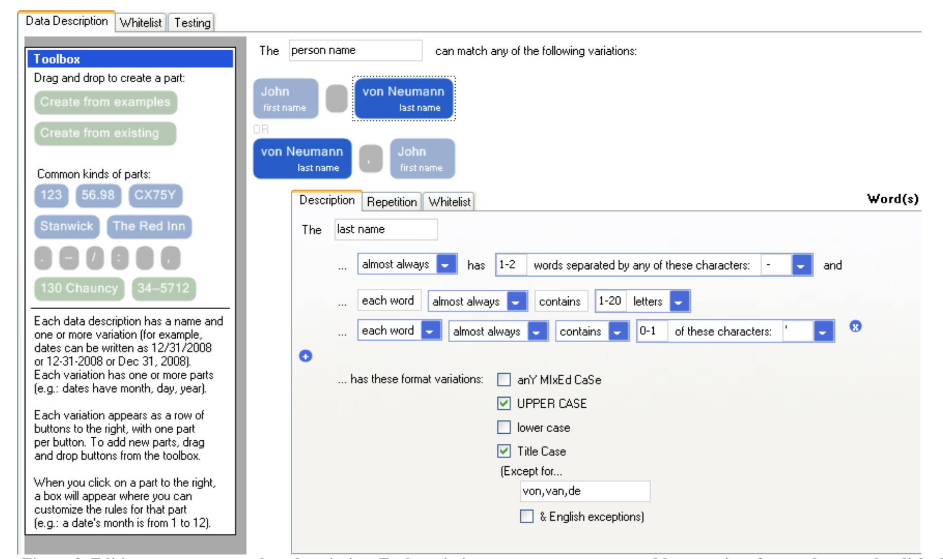
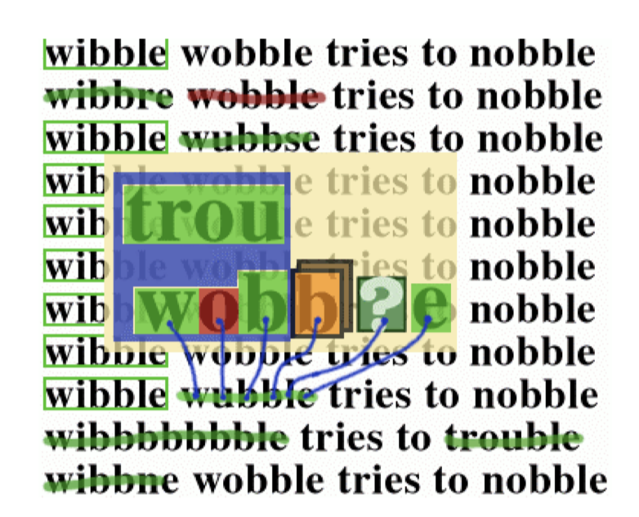
Related Work
Programming-by-demonstration
Toped⁺⁺, 2009
Good for text and lookups
Too limited, does not support filtering, reshaping, or aggregation
SWYN (See What You Need), 2001
Visual regular expressions with previews
Limited in similar ways
PBD applications are limited in operations, often lack provenance capabilities

Slide 4
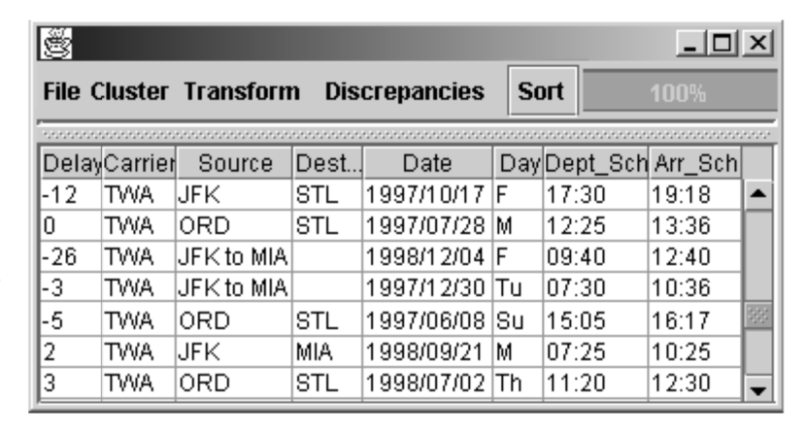
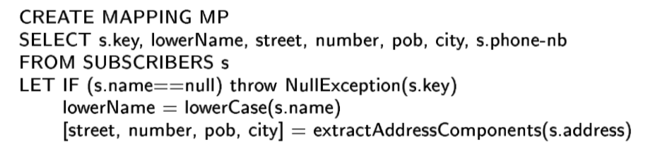
Related Work
Interactive Data Cleaning
Potter’s Wheel (2001)
Ajax (2000)
Google Refine
Lack of expressiveness: no direct manipulation

Slide 5
Wrangler Transformations
Maps
Delete, extract, cut, split, update
Lookups
Joins
Reshape
Fold, unfold
Positional
Fill, lag
Sort, aggregation, key generation, schema transforms

Slide 6
Interface
Interactions
Select row
Select column
Click data quality bar
Select text
Edit value
Assign column names, data types or semantic roles

Slide 7
Inference Engine
Each parameter independent of other parameters
3 types of transform parameters:
Row:
“row is empty”
“column [equals | starts with | ends with | contains] selected- value”
Column
Interacted columns

Slide 8
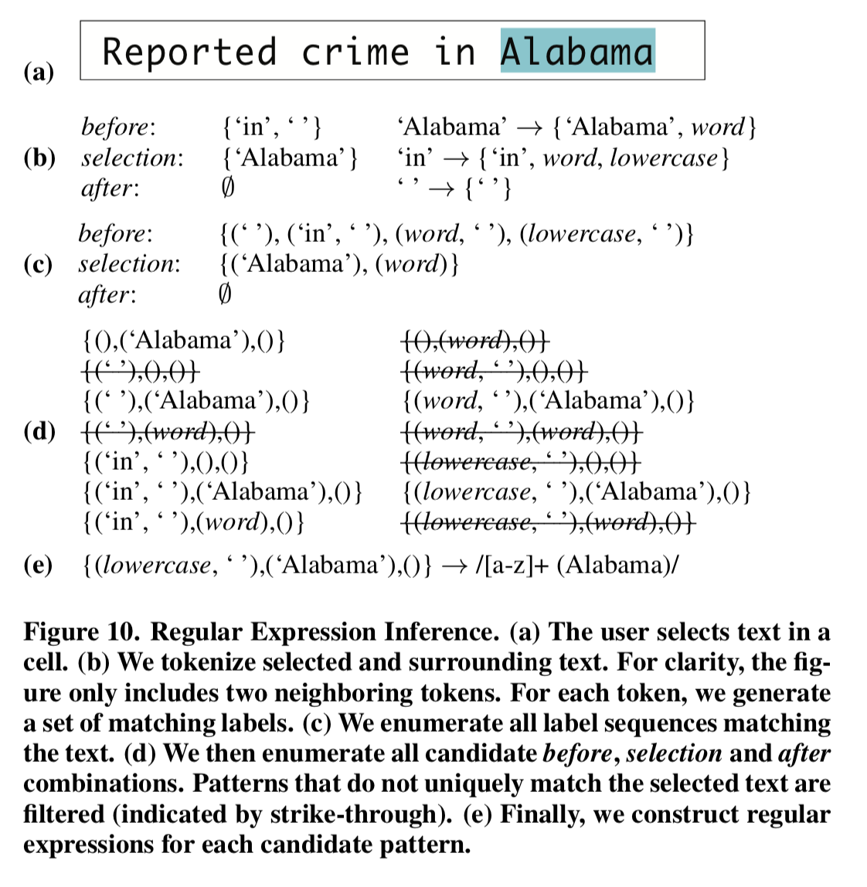
Inference Engine
Text
Index range
Regular expression generation
5 token window around selection
Generate ll label sequences for before, after, and within selection
Filter out non-unique patterns
Generates list of transforms that can take in the generated parameters

Slide 9
Inference Engine
Ranking transformation suggestions
Using user corpus (initialized by researchers, then built up over studies)
Matches on equivalence — same transform type and equivalent parameters
Ranking criteria (1-3 based on transform type, 4-5 within):
Explicit interactions
Specification difficulty
Label, row, text are easy, all others are hard
Corpus frequency, given preceding interaction
Corpus frequency within transform type
Transform complexity (generated score)
Filter for diversity

Slide 10
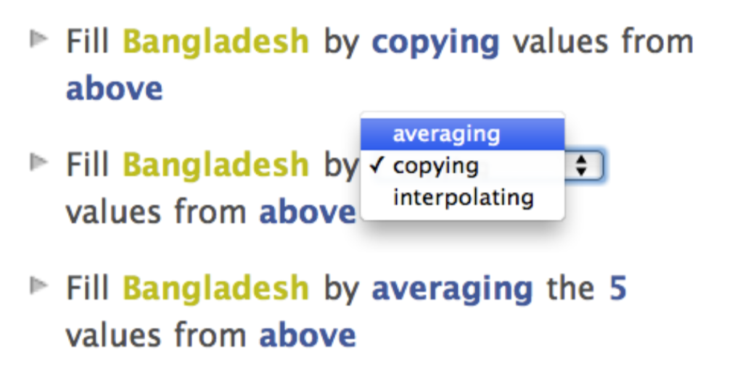
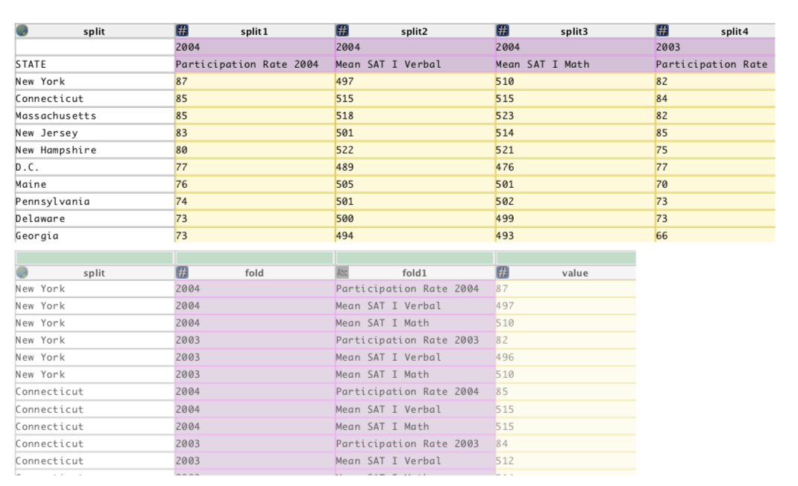
Interface
Editable natural language descriptors of transforms
Cut down for concision, default parameters omitted
Pattern substitution to make regular expressions readable (not for custom regular expressions)
Visual previews
Selection (highlight)
Deletion (colored in red)
Update (overwrite and shade in yellow)
Column (display new column)
Table (side-by-side of new table)

Slide 11
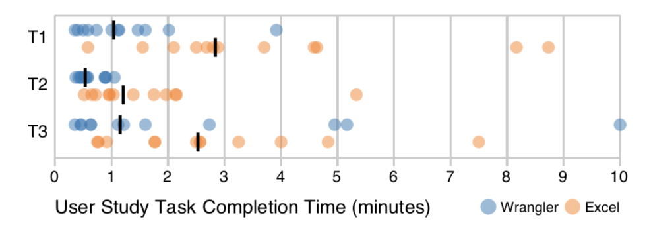
Evaluation
Compared against Excel: popularity, had same capability as Wrangler
12 participants, skilled in data
10 minute tutorial on Wrangler
3 tasks:
Extract text
FIll missing values
Reshape table structure

Slide 12
Discussion
Use Cases:
Who is Wrangler’s target audience?
How does using Wrangler compare to just writing an ad-hoc program? Easier? Faster?
Engine:
Is the ranking algorithm effective?
Evaluation:
Was evaluating only against Excel sufficient? Should they have included other, less expressive, systems?

Slide 13
A Collaborative Framework for Structure Identification over Print Documents
Maeda F. Hanafi, Miro Mannino, Azza Abouzied

Slide 14
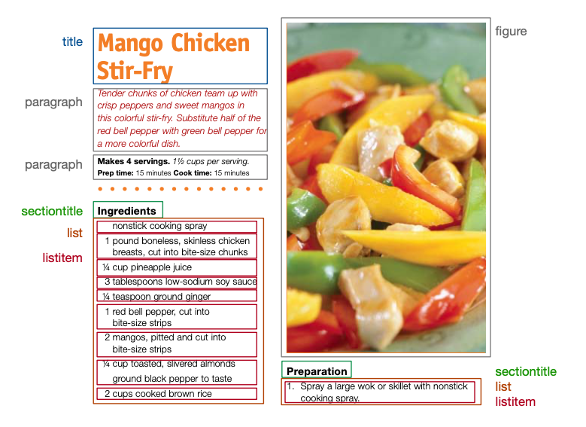
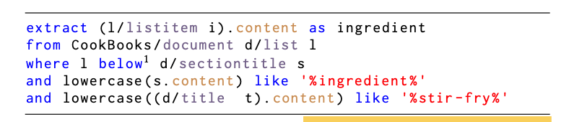
Overview - Data Extraction over Print Documents

Slide 15
Overview - Data Extraction over Print Documents
A vast amount of information is sealed in print
Related tools: Refiner, PDFFigures
Notes:
PDFFigures: Figures, tables and captions in PDFs

Slide 16
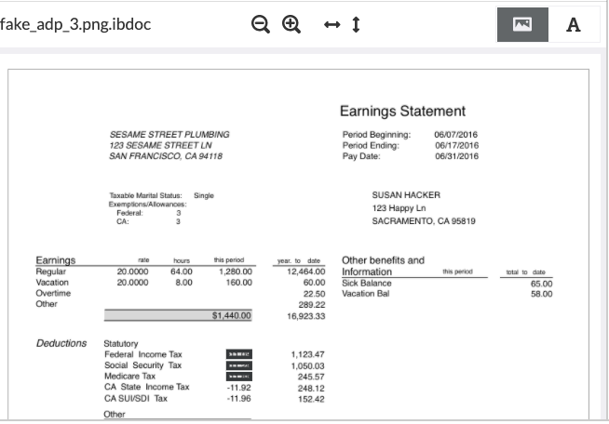
Refiner

Slide 17
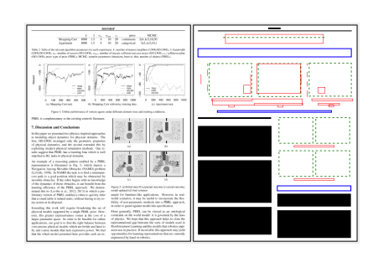
PDFFigure2.0
Clark, Christopher, and Santosh Divvala. "Pdffigures 2.0: Mining figures from research papers." 2016 IEEE/ACM Joint Conference on Digital Libraries (JCDL). IEEE, 2016.

Slide 18
Introduction
Two-stage approach
First stage: identify structural elements from documents (title, header, footer...)
Second stage: extract information over the identified structures using domain specific language
This paper mainly talks about the first stage

Slide 19
Related Work
Train an ML model to label relevant data
Crowd-source the data extraction task
Hire freelance developers to write data extraction code

Slide 20
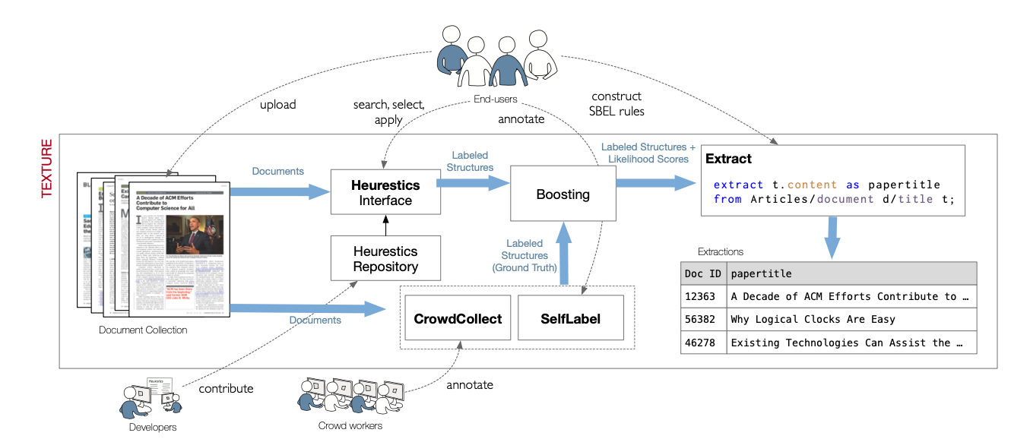
System Overview

Slide 21
Developers
Contribute heuristics to code repository
Provide unit test and a test document set
Texture provides some basic methods (e.g. getContent)

Slide 22
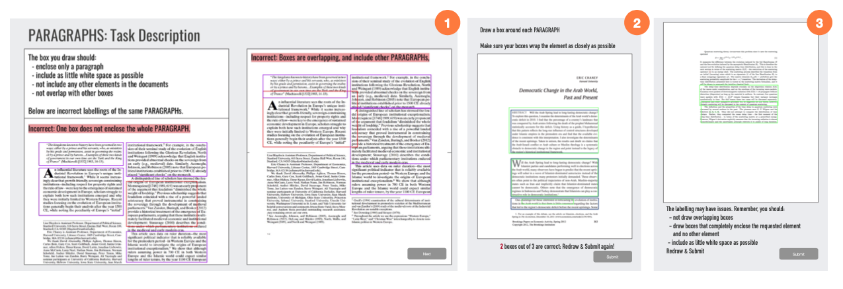
Crowd Workers / Annotators
CrowdCollect: collect structure labels from the crowd
some rules to assure quality: hidden validation, training...
Currently generate Amazon Mechanical Turk kit

Slide 23
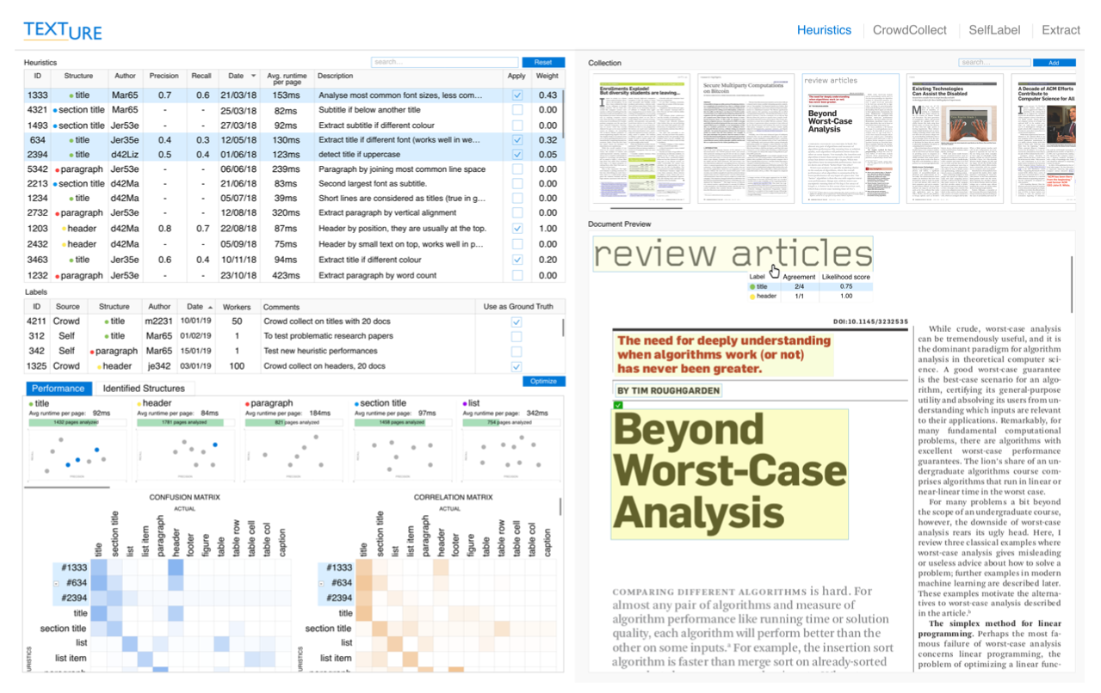
End Users

Slide 24
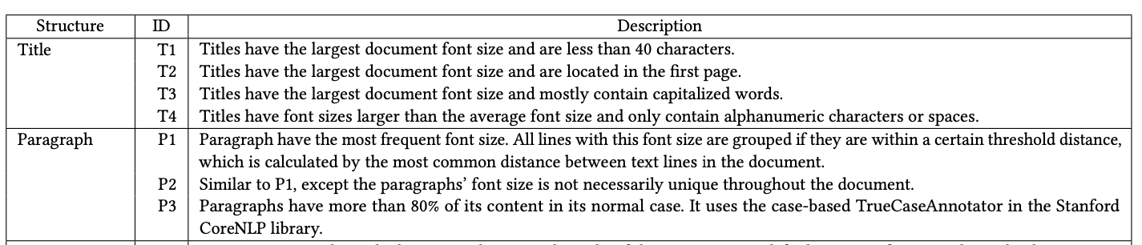
Evaluation
5 CS undergraduate students to develop heuristics

Slide 25
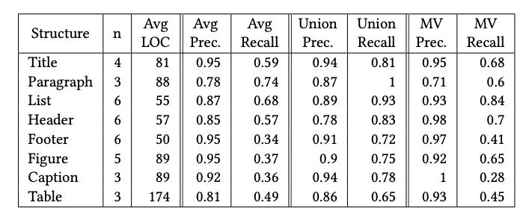
Evaluation
Data: 100 pages for each structure, crowd-source for ground truth

Slide 26
Discussion
How will Texture be used in real world?
Do you think the evaluation is good for accessing the system? If not, what kind of evaluation is needed?

Slide 27
Textual Human Data Interfaces
Week 11

Slide 28
Welcome Back!
What’s one thing awesome you did since our last class?

Slide 29
Administrivia
Check-ins
A3 due yesterday
A4 due Apr 6th
Guest lecture next week

Slide 30
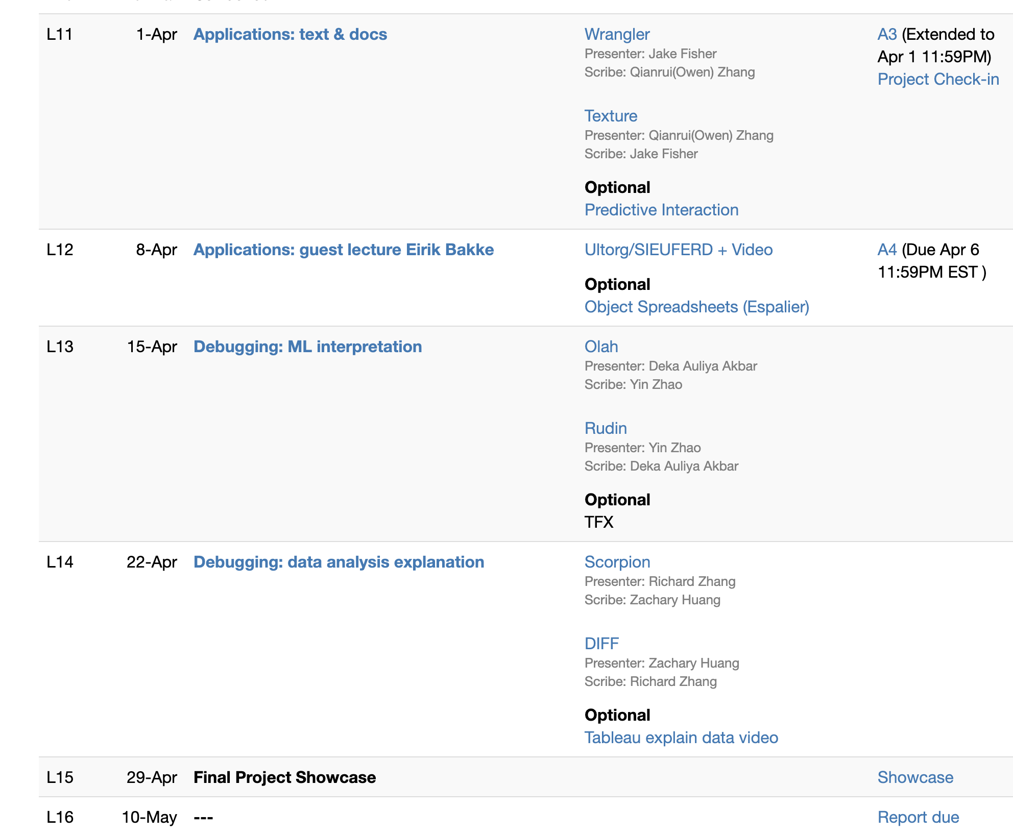
Today

Slide 31
Wrangler
Presenter: Jake Fisher
Scribe: Qianrui (Owen) Zhang
Texture
Presenter: Qianrui (Owen) Zhang
Scribe: Jake Fisher

Slide 32
Wrangler Discussion

Slide 33
Wrangler thoughts
Strengths compared to programming, excel?
Weaknesses/Concerns?
Overall, when is programming by example appropriate?

Slide 34
Wrangler thoughts
Strengths compared to programming, excel?
Easier to select what you want to extract than to write code
Previews of options
Weaknesses/Concerns?
Overall, when is programming by example appropriate?

Slide 35
Wrangler thoughts
Strengths compared to programming, excel?
Easier to select what you want to extract than to write code
Previews of options
Weaknesses/Concerns?
Doesn’t do everything well, but not integrated with e.g., notebooks
In-place previews relies on low latency
Scalability
Overall, when is programming by example appropriate?

Slide 36
Texture Discussion

Slide 37
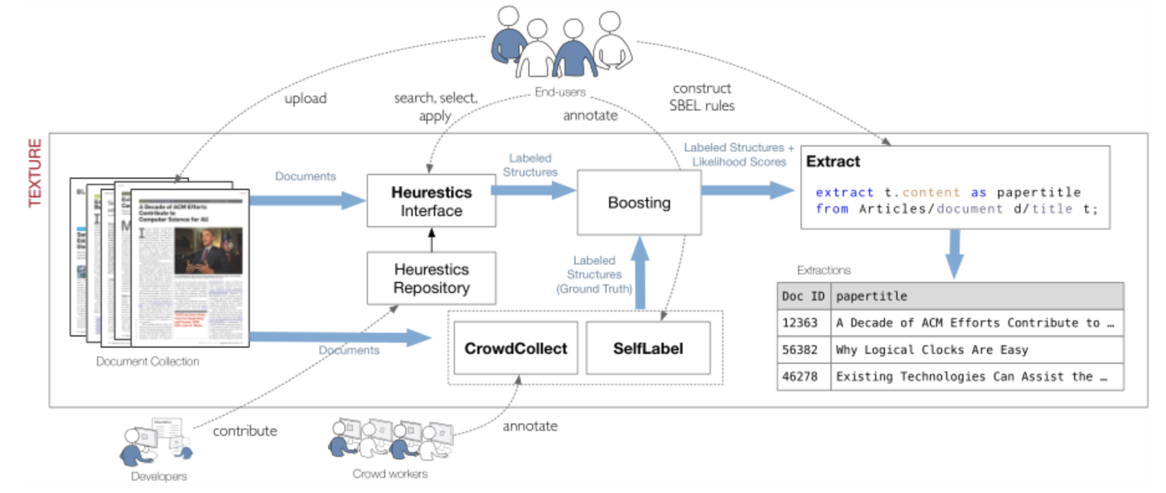
Real use case for Texture?

Slide 38

Real use case for Texture?
Query-ers
Tables
Query Plan
Extract Boxes
Query Executor
Heuristics/UDFs
Function Implementers

Slide 39
Real use case for Texture?
Examples of…
Documents
End Users
Developers
Notes:
covid

Slide 40
General Discussion

Slide 41
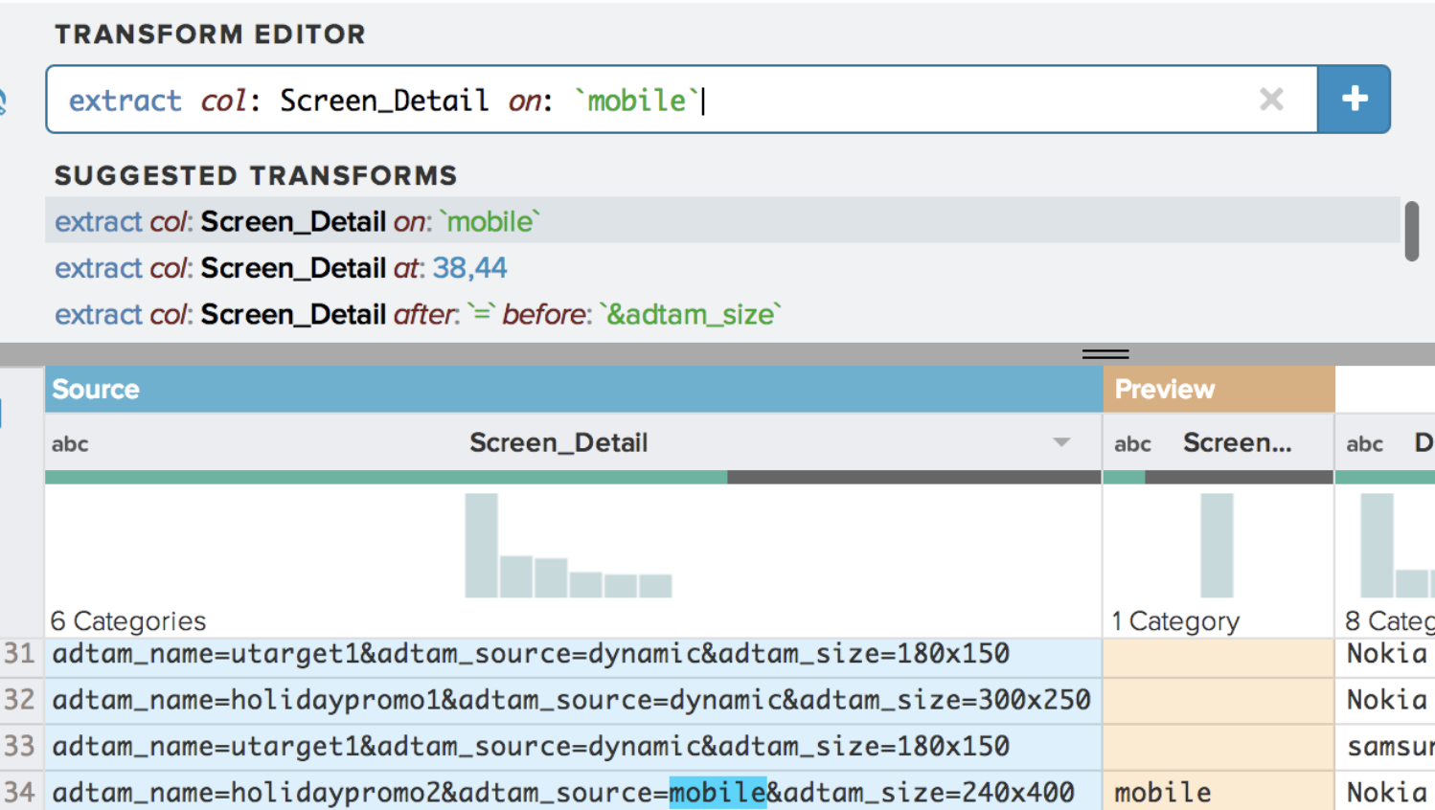
Predictive Interaction (Heer, Hellerstein, Kandel 15)
Ranked
Suggestions
1…
2…
3…
User
Interaction
Rendered Results
(could be sample)
choose
visualize
compile
Data
Write Code
Results

Slide 42
Predictive Interaction (Heer, Hellerstein, Kandel 15)
User Visualization/Interface Space
visualize
compile
Data
Write Code
Results

Slide 43
Predictive Interaction (Heer, Hellerstein, Kandel 15)
User Visualization/Interface Space
Domain Specific Language
visualize
compile
Data + Code Space

Slide 44
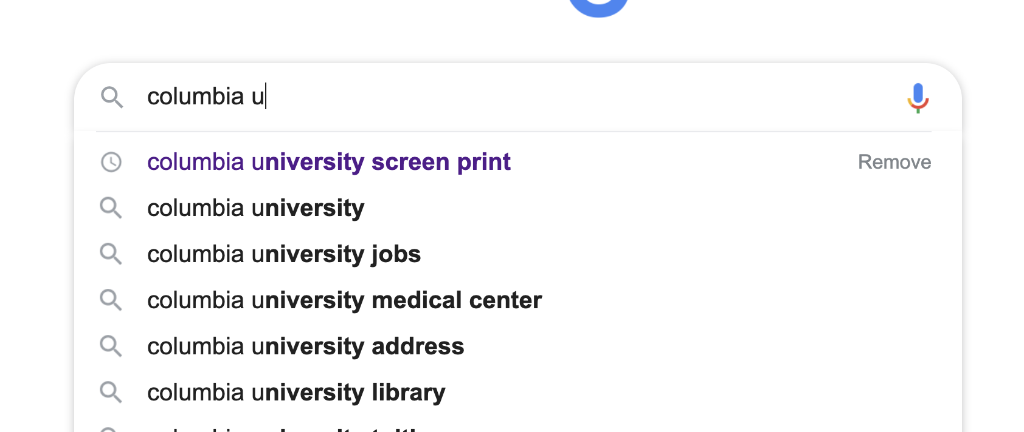
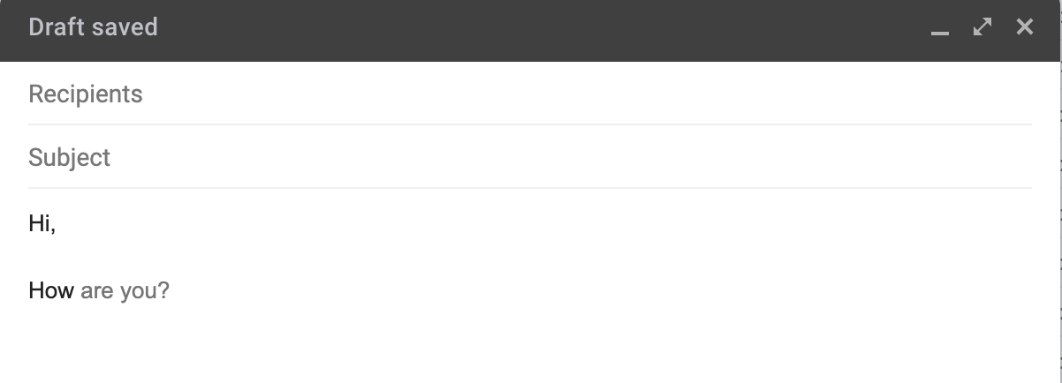
How best to combine HDIs and AI?
Provide shared representation: DSL
AI: generate and rank suggestions in DSL
Users: review, select, edit, ignore suggestions

Slide 45
How best to combine HDIs and AI?
Provide shared representation: DSL
AI: generate and rank suggestions in DSL
Users: review, select, edit, ignore suggestions
Examples of DSLs
Tableau:
Voyager:
Wrangler:
Texture:

Slide 46
How best to combine HDIs and AI?
Provide shared representation: DSL
AI: generate and rank suggestions in DSL
Users: review, select, edit, ignore suggestions
Examples of DSLs
Tableau: VisQL
Voyager: vega-lite
Wrangler: wrangler transforms
Texture: SBEL extraction rule

Slide 47
How best to combine HDIs and AI?
Provide shared representation: DSL
AI: generate and rank suggestions in DSL
Users: review, select, edit, ignore suggestions
Principles
Positive value (for user tasks)
Low overhead: augment, not replace, user interaction
Doesn’t decrease value
Better over time

Slide 48
Why Combine HDIs and AI anyways?
Data tasks are ill-formed. User iteratively identifies the task
Data science, cleaning, exploration, creativity
Big design + action (programs) space
Big and unknown task (goals) space
Imperfect AI

Slide 49
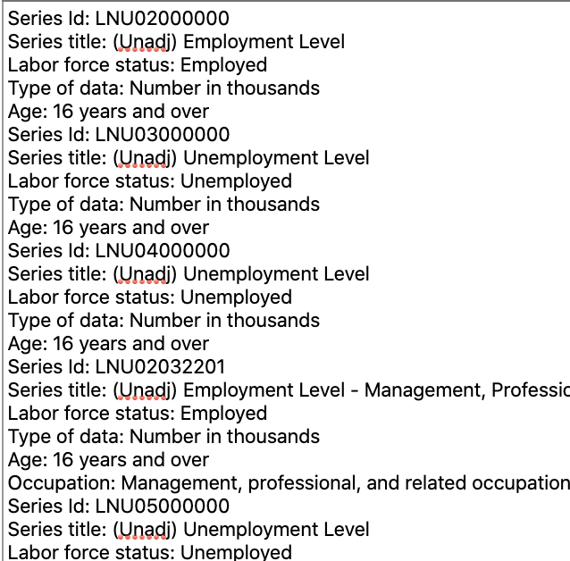
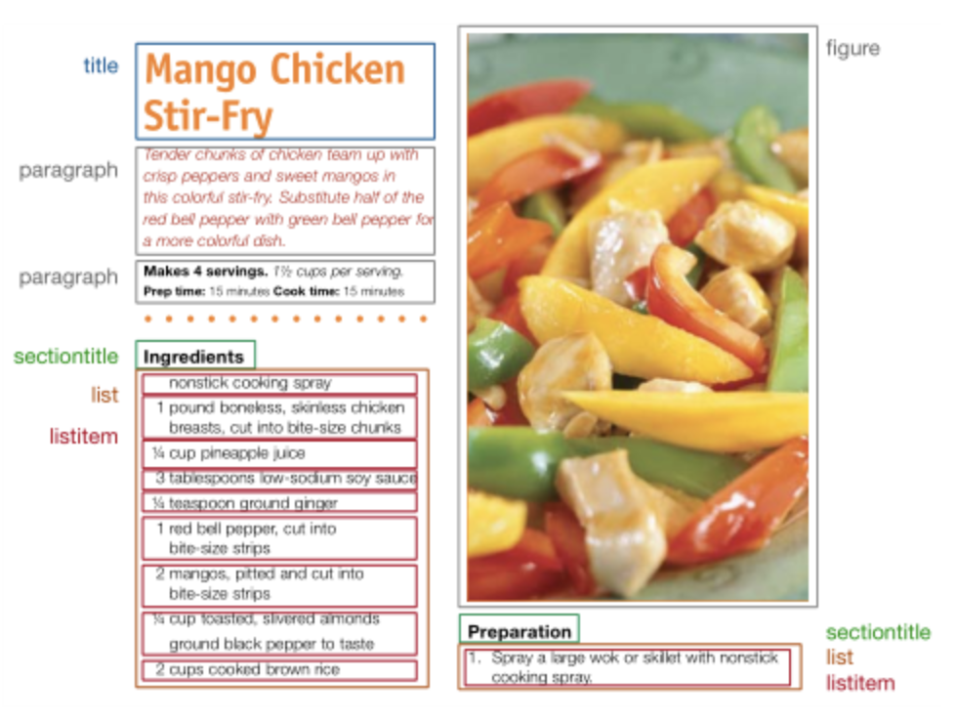
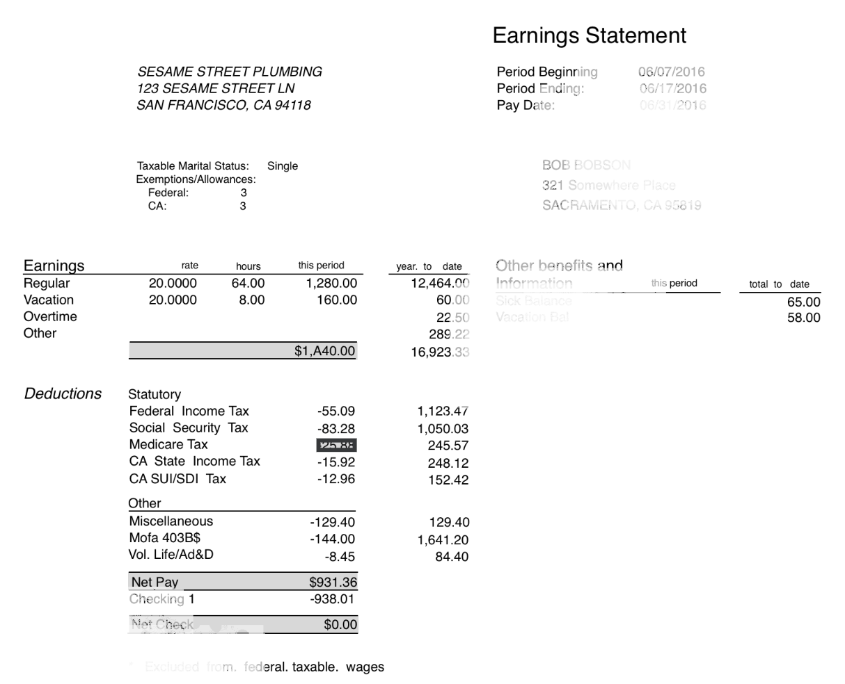
Contrast between the three systems
Wrangler
csv/text
Texture
Print docs
Instabase
structured docs

Slide 50
Compare: Problems They Tackle
Wrangler
Texture
Instabase
Extracting from text is hard
Extraction is self contained to a single cell
Documents have similar types of data (titles, paragraphs)
Lots of design variation in docs
Low design variation
Extraction is contextual

Slide 51
Compare: Assumptions About Setting/Users
Wrangler
Texture
Instabase
Individual user
Novices, not programmers
Prioritize learnability
Hide programming API
Full service running in a company, with developer staff
2 types of users
Developers can write extraction heuristics
End users have documents and want to extract text from docs
End users not progremmers
Organization with valuable document data
Deeply understand their docs
Programmers

Slide 52
Compare: How They Model the Problem
Wrangler
Texture
Instabase
Data model
Language
User Interaction
Data model
Developer Interaction
User Interaction
Data model
Language
User Interaction

Slide 53
Compare: How They Model the Problem
Wrangler
Texture
Instabase
Data model
Table of text attributes
Language
Filter, project operators + fold/unfold
User Interaction
Select text to extract
Choose & refine suggestions
Data model
Developer Interaction
User Interaction
Data model
Language
User Interaction

Slide 54
Compare: How They Model the Problem
Wrangler
Texture
Instabase
Data model
Table of text attributes
Language
Filter, project operators + fold/unfold
User Interaction
Select text to extract
Choose & refine suggestions
Data model
Typed bounding boxes (title, list)
Boxes have metadata
Doc = hierarchy of boxes
Developer Interaction
Write bounding boxes detectors and labelers in Java
Heuristics populate the “database”
User Interaction
Write extraction “queries” over “database” of boxes
Data model
Language
User Interaction

Slide 55
Compare: How They Model the Problem
Wrangler
Texture
Instabase
Data model
Table of text attributes
Language
Filter, project operators + fold/unfold
User Interaction
Select text to extract
Choose & refine suggestions
Data model
Typed bounding boxes (title, list)
Boxes have metadata
Doc = hierarchy of boxes
Developer Interaction
Write bounding boxes detectors and labelers in Java
Heuristics populate the “database”
User Interaction
Write extraction “queries” over “database” of boxes
Data model
Document image
OCR that preserves spatial struct.
Language
Extract relative to anchors
Anchors based on visual+text
User Interaction
Manually write functions
Shows extracted bounding boxes in doc & text

Slide 56
Compare: Errors & Verifying that “It Worked”
Wrangler
Texture
Instabase
User sees previews
Edit transform if it’s only slightly wrong
User can get stuck if suggestions are all bad
Manually choose transform
Heuristic could be wrong?
Manual labels as ground truth
Crowd could be wrong?
Ask 5 workers
User chooses wrong heuristic? Preview boxes in documents
”Database” is not populated correctly or not fully populated?
“Query” doesn’t work for many documents?
Function was wrong?
Render bounding boxes
Function doesn’t work for many documents?
Assumes docs have same structure.

Slide 57
Compare: Why Focus on HDI?
Wrangler
Texture
Instabase
Selecting desired text is easier than writing regex
Seeing previews is good
Documents have similar types of data (titles, paragraphs)
Lots of design variation in docs
Less data variation
Low design variation
Element to extract is hard

Slide 58
Why Do They Focus on Interaction?
Wrangler
Same Goals: extract tables for text documents/inputs
Why not just build better ML models?
What users want extracted depends on the user
Lack of labels for each task
Shared building blocks across tasks, but different compositions
Point and select content
Box detection, visual features (positioning, size)
User interaction
Language to solve task
Interface and interactions to help use the language
Texture
Instabase
Notes:
Similar to SQL

